Slide 1
NEO4J CYPHER TUTORIAL WITH PYTHON
Avg & collect operator
Tutorial 58

Slide 2
AVG Operator
Definition
avg() returns the average of a set of numeric values.
Any null values are excluded from the calculation.

Slide 3
AVG Operator
FIND THE AVG AGE
Using NEO4J BROWSER
create (a:PLAYER{NAME:"MESSI",AGE:31}),(B:PLAYER{NAME:"RONALDO",AGE:33}),(C:PLAYER{NAME:"SUAREZ",AGE:31}),(D:PLAYER{NAME:"NEYMAR",AGE:26})
AVG_AGE
30.25

Slide 4
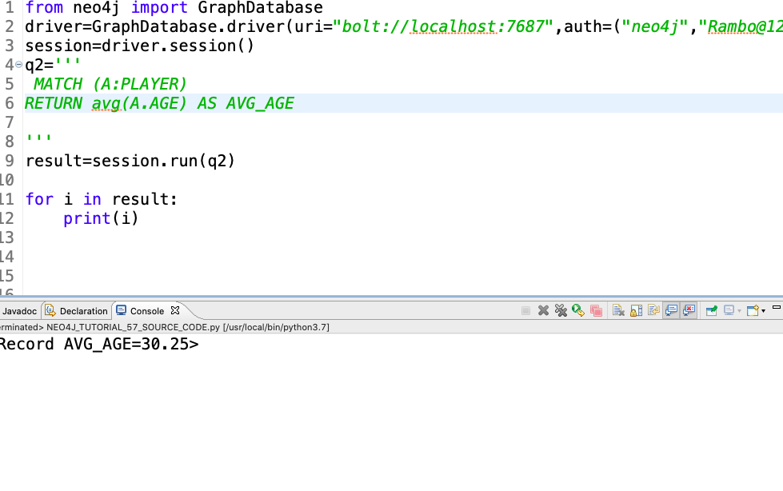
AVG Operator
FIND THE AVG AGE
Using PYTHON IDE

Slide 5
Collect Operator
Definition
collect() returns a list containing the values returned by an expression. Using this function aggregates data by amalgamating multiple records or values into a single list.

Slide 6
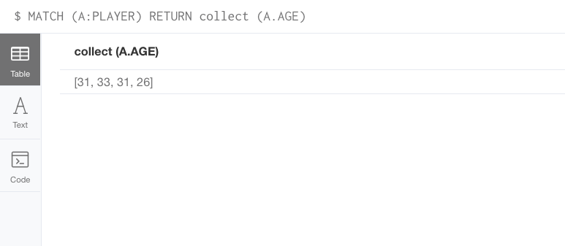
COLLECT Operator
FIND THE ALL AGES IN LIST FORM
Using NEO4J BROWSER

Slide 7
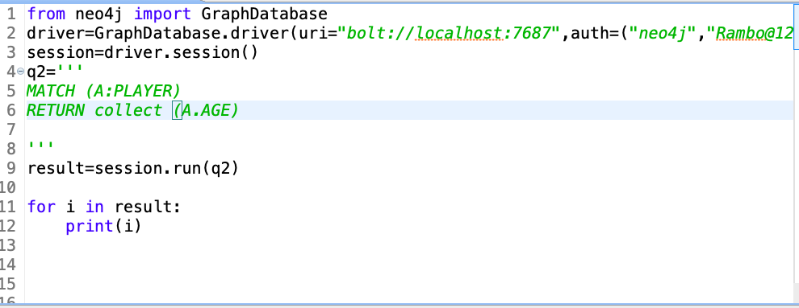
COLLECT Operator
FIND ALL THE AGES IN LIST FORM
Using PYTHON DIE

